Slide 1

Level Up! Gym
Business Plan Presentation
Presented by
Chelsea Ferguson and Christopher Sigouin

Slide 2
Company Description
A video game exergaming facility dedicated to provide a unique fitness experiences and lots of fun!
Core Values
Fun. Fitness. Motivation. Leadership. Health. Well-being

Slide 3
Type of Gym Goers
Gamers
Video game enthusiasts
Young and old
Fitness fanatics
Know their way around a gym
Looking for a new way to further their skills
Beginners
Members new to fitness
Modern Adults / Elderly
Those familiar with today’s technologies (Apps)

Slide 4
Products and Services

Slide 5





Products
Power Up! Bar
Protein Shakes, Protein Bars
Health/Mana Potions
Healthy Snacks
Trail Mixes
Local Produce

Slide 6
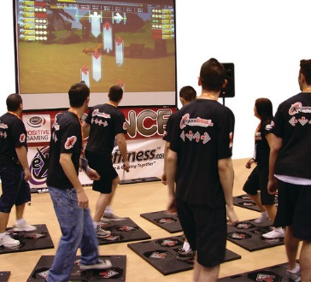
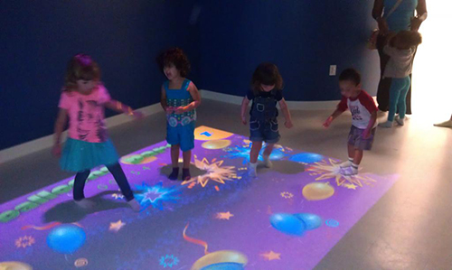
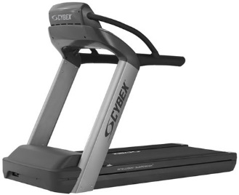
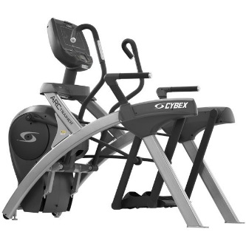
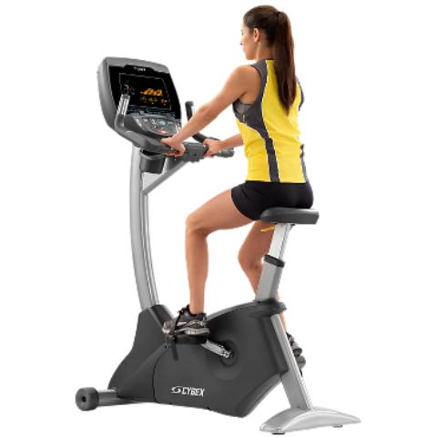
Products - Equipment

Slide 7






Slide 8





Achievement Unlocked

Slide 9
Services
Fitness Classes
Video game inspired fitness classes available throughout the week
Memberships
A variety of memberships for everyone from students to business, adults and families
Kid’s Zone
From 9am to 2pm, schools can book this for one or two classes to play, have fun and get exercise
Game Zone
Gaming rooms that contain a large television and a game console in which gym goers can play popular fitness games using motion sensing technology.
1 to 8 people can play at a time
Party Play
Members can rent one or more Game Zones for a party.
Can be for children’s birthday parties or just hanging out with friends

Slide 10
Services – Level Up! App
Unique profile for each member
Contains their stats
Personal
Fitness
Game
Level ups!
As a member works out they gain experience to level up their personal level
Tracks levelling in the exergaming equipment

Slide 11
Organizational Plan

Slide 12






Organizational Plan – Stage Development
Current Operational Development Status and Requirements
Industry Association Memberships
Suppliers

Slide 13
Organizational Plan – Production Process
Day-To-Day Operations
General Rules and Regulations
Facility Hours, Duties and Operations
Feasibility ( Product & Prototype testing )
Physical Location

Slide 14
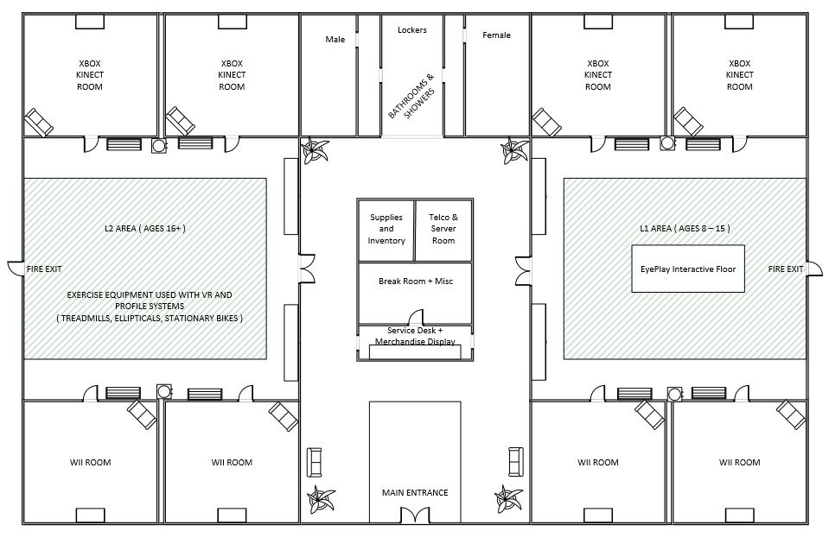

Slide 15
Marketing Plan

Slide 16
4 p’s

Slide 17
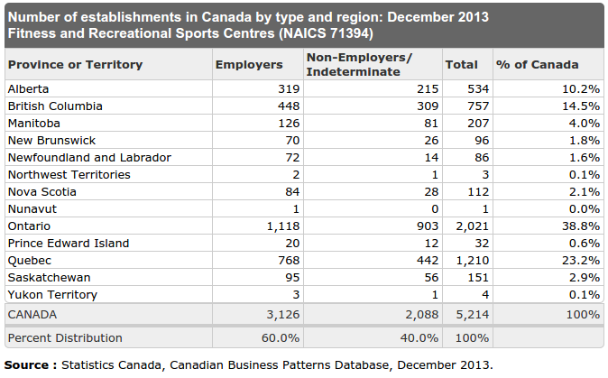
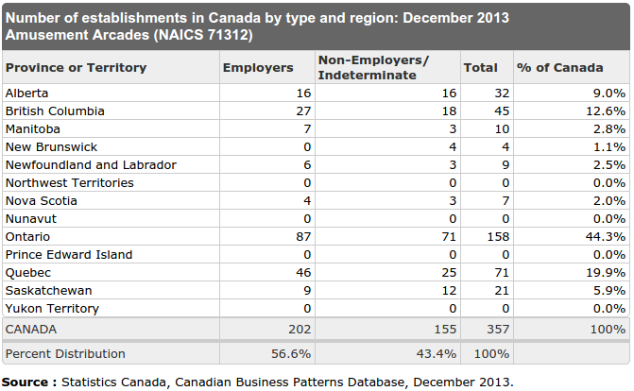
Marketing Plan

Slide 18

Website Mock-Up

Slide 19
Management Plan

Slide 20
Management Plan
Chelsea Ferguson
[Chief Executive Officer]
Christopher Sigouin
[Chief Operating Officer]
Fitness Professionals
Cleaning Staff
Michael Gergely
[Chief Financial Officer]

Slide 21
Marketing – Personnel Plan
General and Personal Fitness Trainers
Daily Sanitization & Hygienic Practices
Terms and Conditions for Memberships

Slide 22
Financial Plan

Slide 23
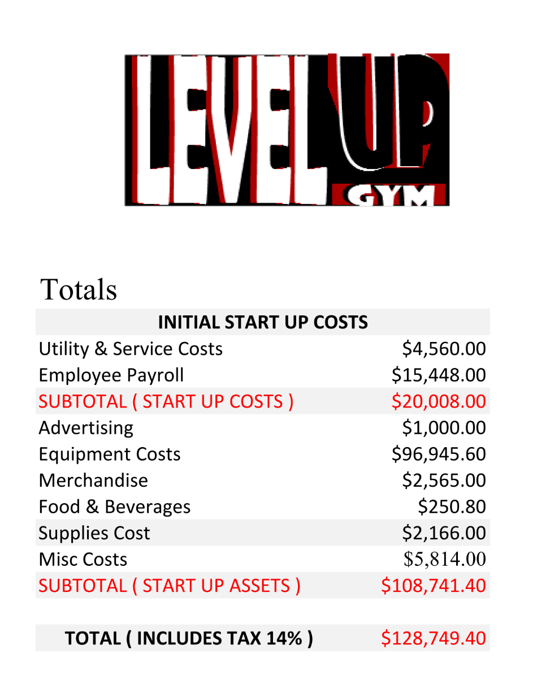
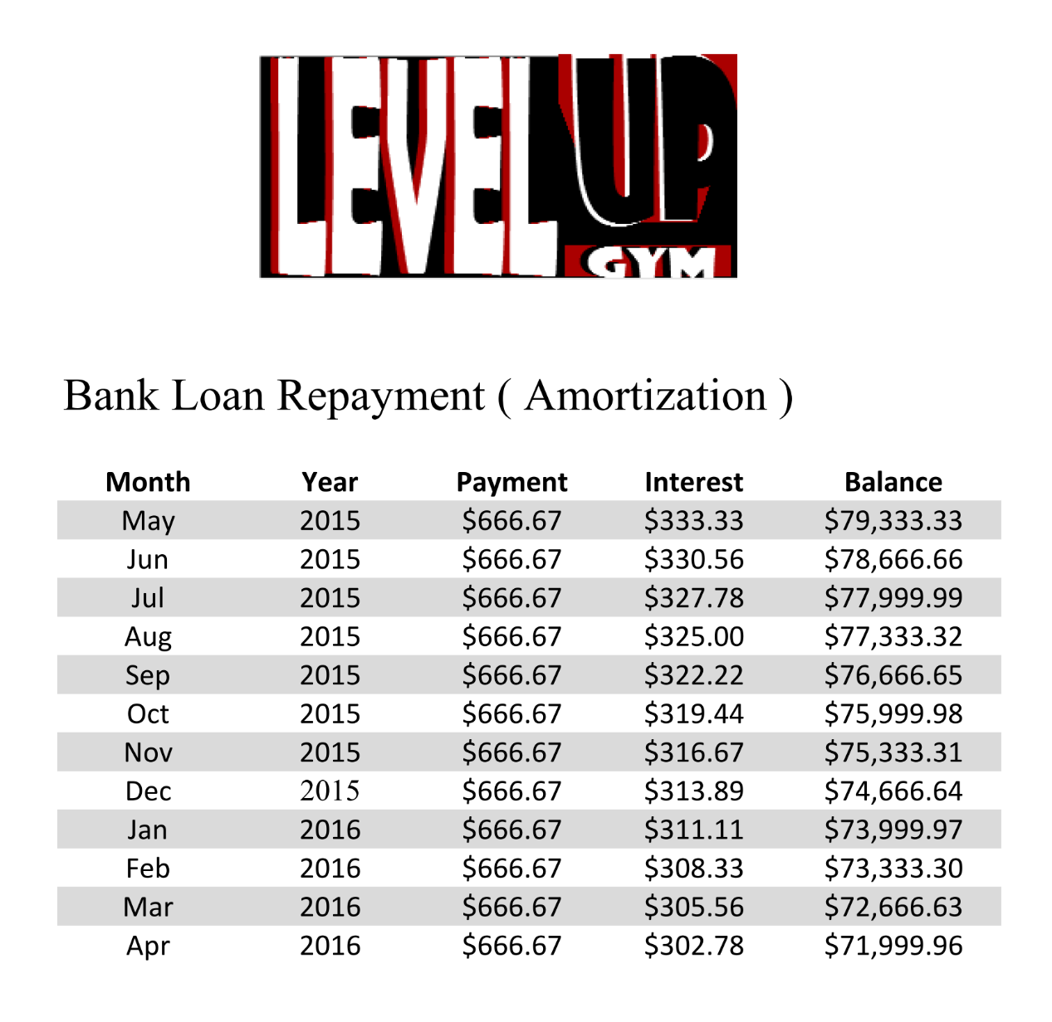

Slide 24
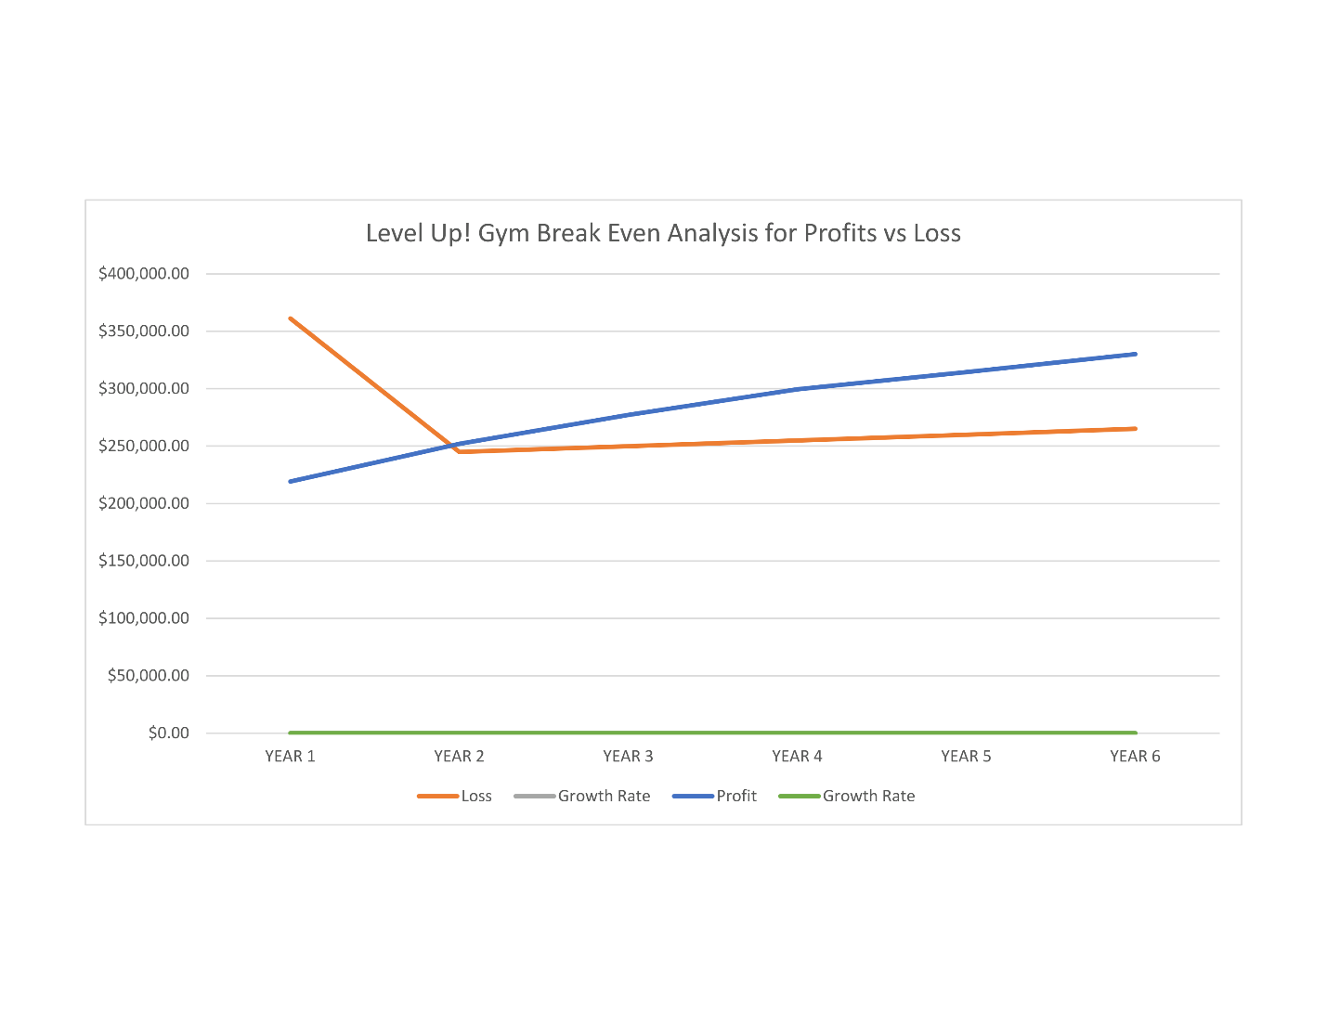
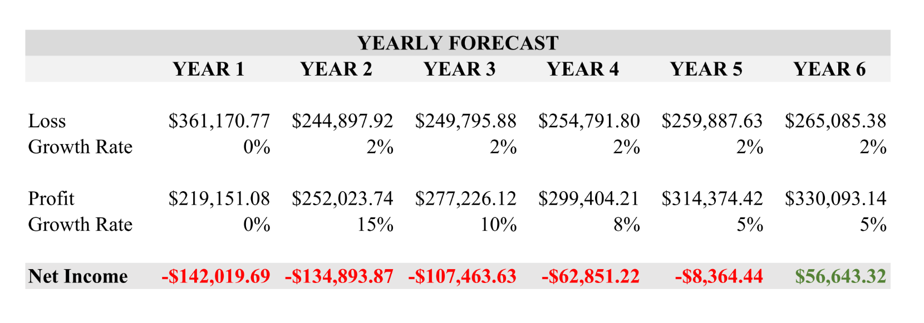

Slide 25
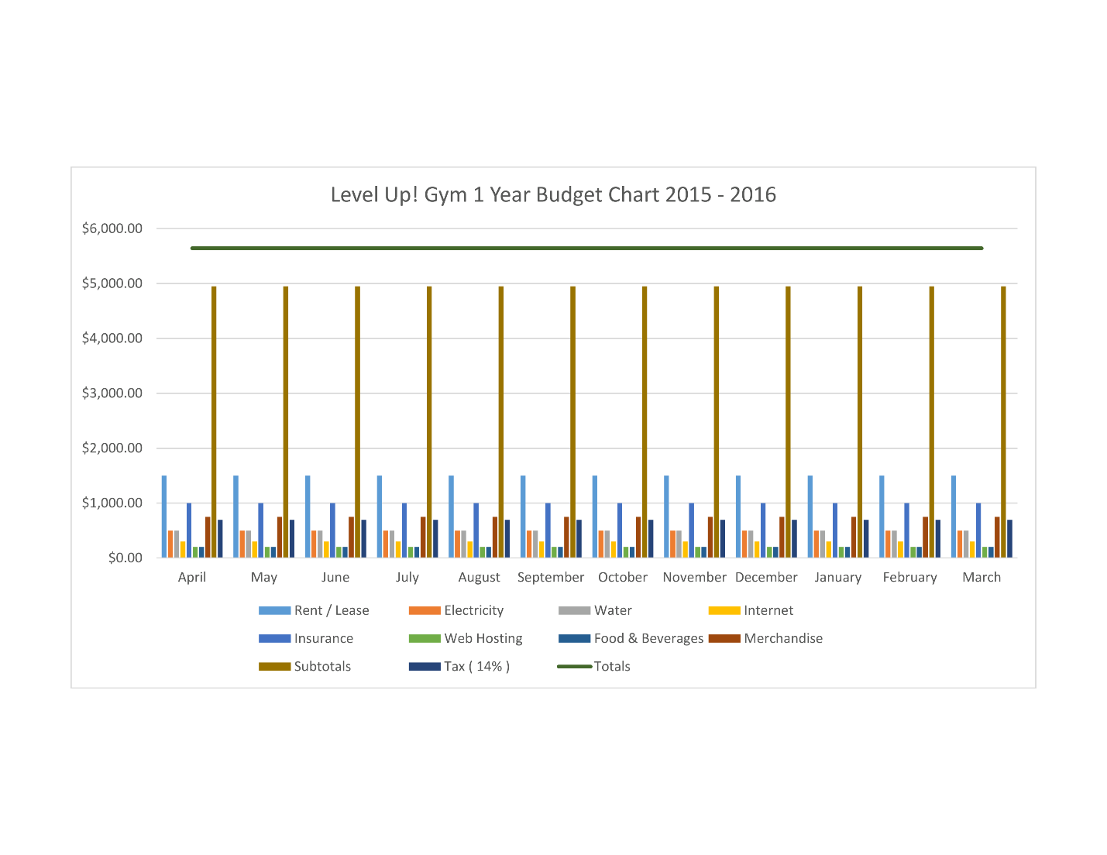

Slide 26

Notes:
https://www.youtube.com/watch?v=zwA8t6IJwxE&feature=youtu.be

Slide 27


Exergaming is the future

